Slide 1


Three Fundamental Religious Changes in America and What They Mean for Parish Ministry.
Hartford Seminary
April 22, 2013
David Roozen, Director
Hartford Seminary Institute
For Religion Research
roozen@hartsem.edu

Slide 2
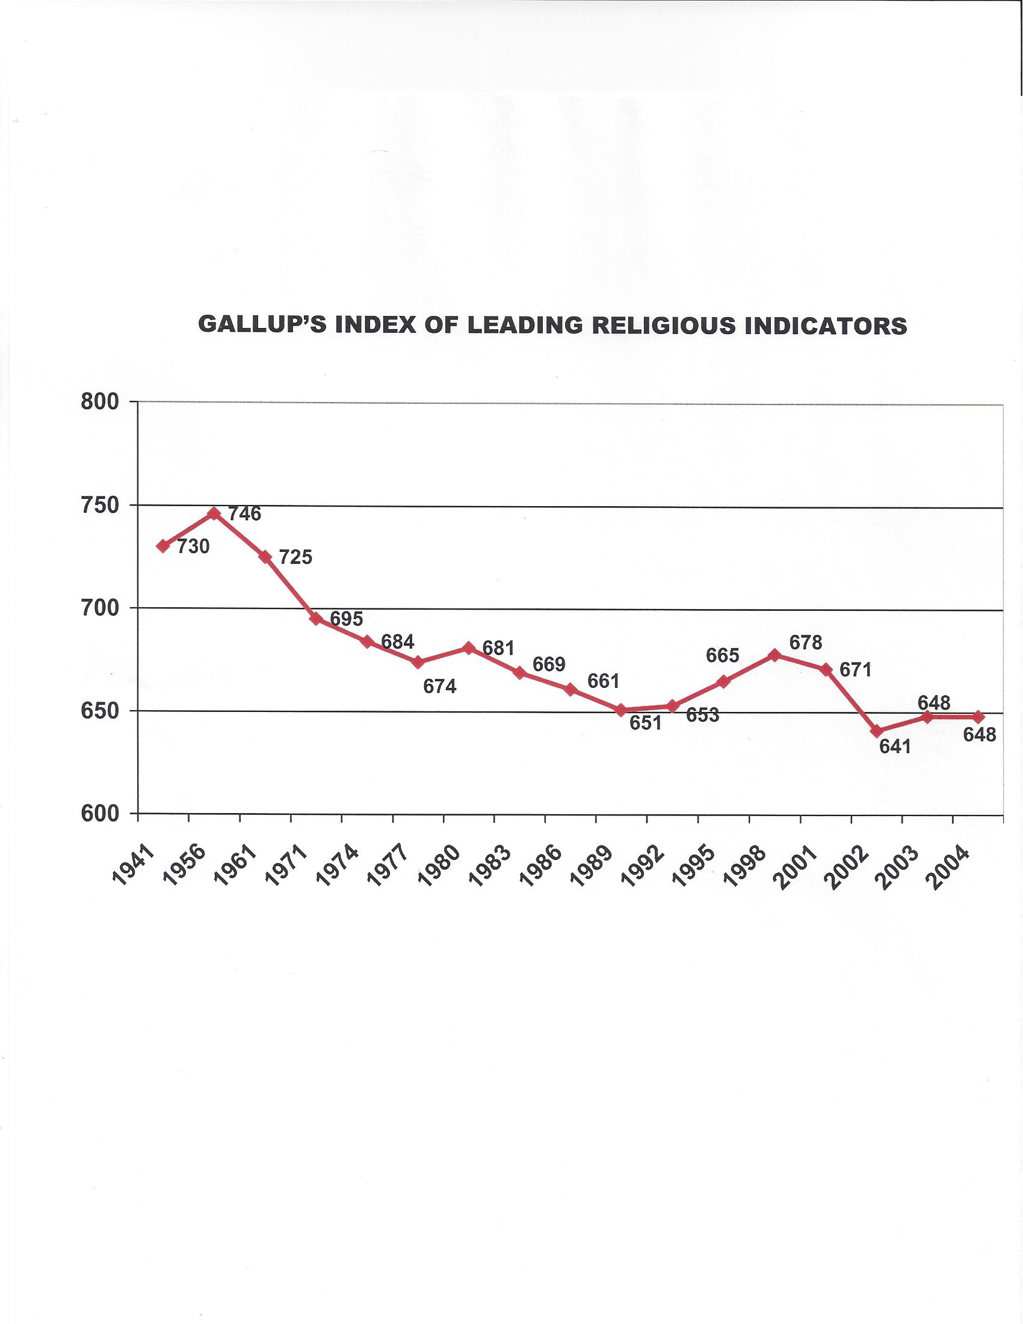

In Regard to Religious Change:
Not A Good Half Century
For the United States
1941 -- 2004

Slide 3
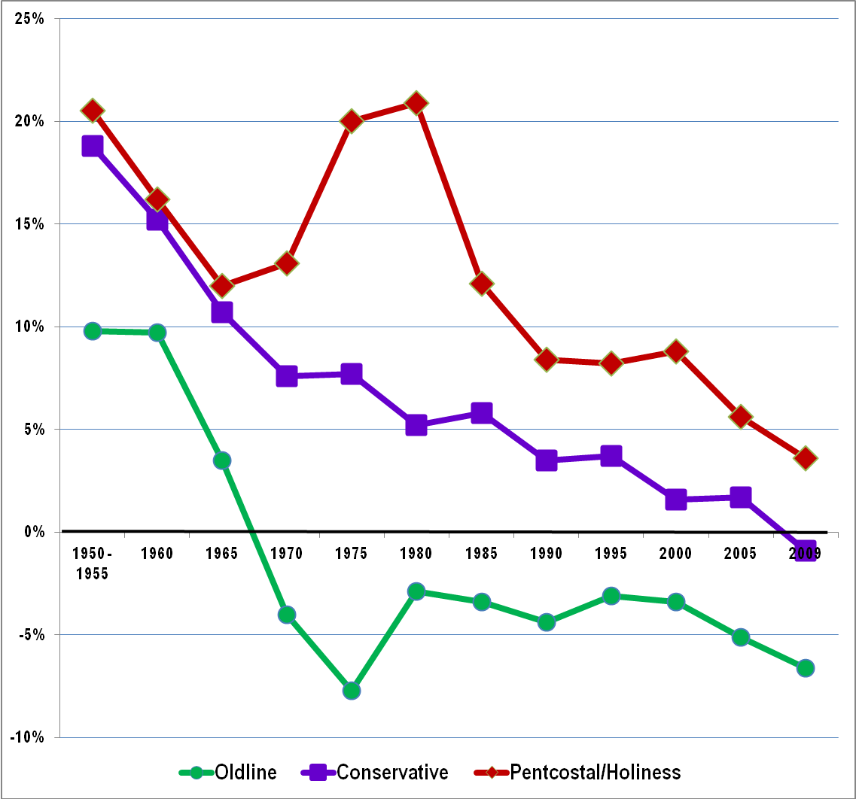
Declines Have Accelerated in the Last Decade
Five Year Rate of Growth or Decline in Membership
Based on data from the Yearbook of
American and Canadian Churches
Episcopal
Presbyterian-USA
United Church of Christ
Church of the Brethren
Evangelical Lutheran-ELCA
Reformed Church of Am
United Methodist
Christian and Missionary Alliance
Cumberland Presbyterian
Evangelical Covenant
Lutheran Church, Missouri Synod
N.A. Baptist Conf
7th Day Adventist
Southern Baptist Conv
Wisc Evang Lutheran Synod
Assemblies of God
Church of God-Anderson
Church of God-Cleveland
Church of Nazarene
Free Methoddist of N.A.
Salvation Army
DAVID ROOZEN ROOZEN@HARTSEM.EDU

Slide 4
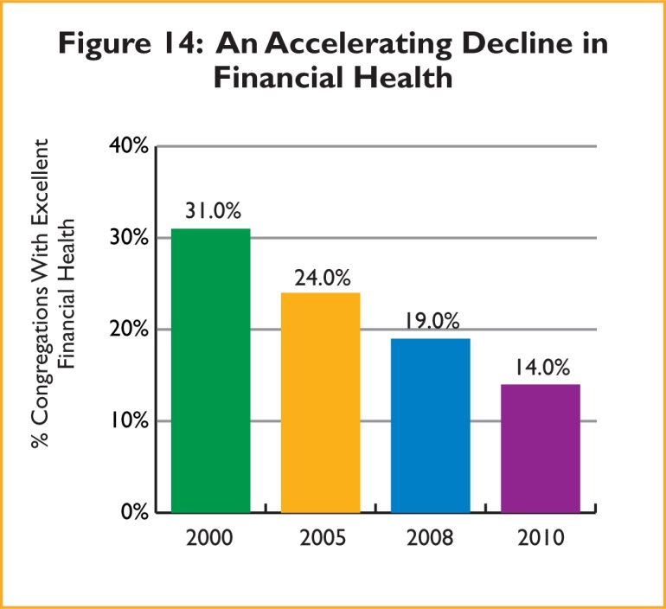
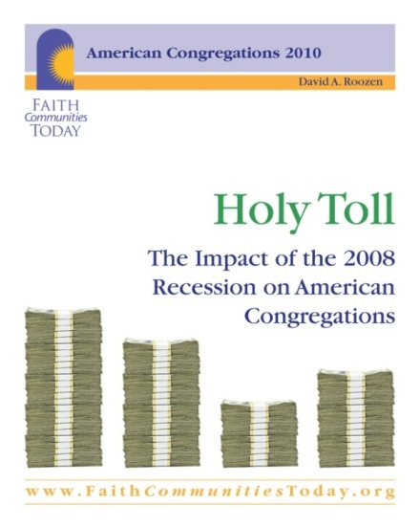
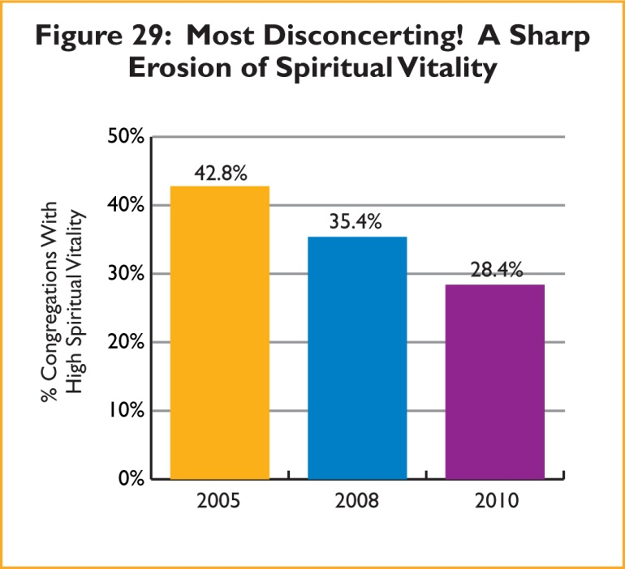
And It Is Not Just
A Matter of People in the Pews,
But Also:
A Steep Drop in Financial Health
And, a Nearly
Equal Drop in
The Spiritual
Vitality of
Congregations

Slide 5
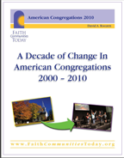
But The Declines Are Only The
“Glass Half Empty” Take On The Decade, which also includes, among other negatives:
● Continuing high levels of conflict, and
Aging memberships.
On The Positive Side, The Decade Brought:
1. A continued increase in innovative, adaptive
worship
2. A surprisingly rapid adoption of electronic
technologies
3. A dramatic increase in racial/ethnic
congregations, many for immigrant groups
4. A general increase in the breadth of both
member-oriented and mission oriented
programs
The decade also gave
Witness to:
5. An increase in
connection across
faith
traditions
6. A twist in the
historical pattern
of religious
involvement in the
electoral process
www.FaithCommunitiesToday.org

Slide 6
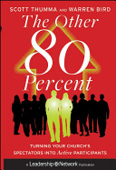
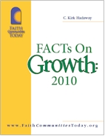
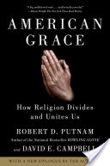
Syllabus
American Religious Trends: Changing World, Changing Ministry* (RS-644) | NEW
Monday, June 3 through Friday, June 7, 9 a.m. to 5:30 p.m.
﻿Most religious leaders are well aware that the world is no longer flat. But neither is it any longer helpful to think of it as round, although it is global to be sure. How do we capture the ethereal and ephemeral nature of the emergent world in which we now are called to religious leadership? A world that, somewhat ironically from a religious perspective, has in only a few years moved from the earthiness of being “wired” to the heavenliness of “the cloud.” And what does it all imply for ministry – both in theory and in practice? Focusing on the American context, these are the questions this course will address – a third on the broad and dramatic demographic and socio-cultural changes of the last quarter century, a third on their implications for ministry, and a third on promising approaches to developing new religious habits and renewed religious communities for the changing world. Among the topics to be covered drawing on lectures, discussion, case studies, guest speakers and students’ experience: the growing generation gap and the disenchantment of the young adult world; the promise and peril of an increasing diverse world (from pluralism to polarization), triaging with purposefulness, spiritual practices and innovative worship, the seeming incongruity of a “missional” cloud, and mega ministries in increasingly smaller congregations.
Within This Tangled Swirl Of
American Religious Change, Our Brief Time
Today Only Allows A Very Cursory
Look At Three Threads:
The Ascendance of Innovative Worship
● The Corrosive, Yet Also Potentially
Energizing Effect of Conflict
● The Opportunities and Challenges of
Increasing Racial/Ethnic Diversity
Further Resources on Congregations & Change
Hartford Seminary Courses and Events, www.hartsem.edu
Webinar: Supersized Believers: What Megachurches Tell Us
About The Spiritual State of Americans And How to
ReachThem Thursday, May 23, 2013 at 8 p.m.
Course: American Religious Trends: Changing World,
Changing Ministry Monday, June 3 through Friday,
June 7, 9 a.m. to 5:30 p.m
Hartford Institute Publications, www.FaithCommunitiesToday.org/
The Other 80 Percent: Turning Your Church's
Spectators into Active Participants
Scott Thumma, Warrant Bird
FACTs on Growth 2010
C. Kirk Hadaway
Most recent and encyclopedic book on religious change in the united States
American Grace: How Religion Divides and Unites Us Robert D. Putnam and David E. Campbell

Slide 7
A Final Word of Preface To help Set The Broader Context:
Three Foundational, MEGA-TRENDS
Changing America’s Religious Landscape
From WORD
to SPIRIT
From PROPHETIC
to POLITICAL
From MISSION
      to WORSHIP
DAVID ROOZEN

Slide 8
Of these, the transition from
Word to Spirit
Is the Most Profound and Foundational
It is not uncommon – indeed it is most typical – for persons to think of religion as a collection of beliefs and doctrines most closely tied to, if not directly drawn from, a sacred Scripture. The beliefs, doctrines and scripture are cognitive and objective (i.e., they are external to the believer). Worship in such a tradition tends to emphasize preaching and the style of preaching is expository. This is what I mean by a religious orientation grounded in
THE WORD.
In contrast, we are becoming increasingly aware that many persons practice religion more in terms of a liturgical or personal relationship to God. Such an approach is more experiential and subjective. (i.e., it is internal to the believer). Worship in such a tradition emphasizes ritual and/or prayer and the gifts of the spirit. If preaching is included it tends to be narrative. This is what I mean by a religious perspective oriented to THE SPIRIT.
The transition from WORD to SPIRIT is, most profoundly, a transition from an EXTERNAL to an INTERNAL locus of authority, and part and partial of this transition is religion as CHOICE.

Slide 9
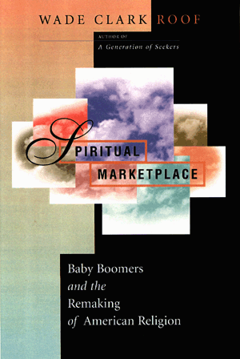
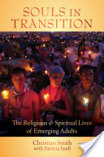

Baby boomer carried Cultural Revolution of the 1960s with its:
Cultural individualism
Ethic of self-fulfillment
Anti-establismentarianism
Church as choice
Spiritual Marketplace: Baby Boomers and the Remaking of American Religion
Wade Clark Roof
The ‘Moralistic Therapeutic Deism” of the Millenials.
Souls in Transition: The Religious and
Spiritual Lives of Emerging Adults
Christian Smith
With Patricia Snell
Still the best single book for understanding the implications of different generationally-related cultural worlds for congregational life!
U. S. Lifestyles and Mainline Churches : A Key to Researching People in the 90's
Tex Sample

Slide 10
From PROPHETIC
to POLITICAL
DAVID ROOZEN

Slide 11
From MISSION
      to WORSHIP
DAVID ROOZEN

Slide 12
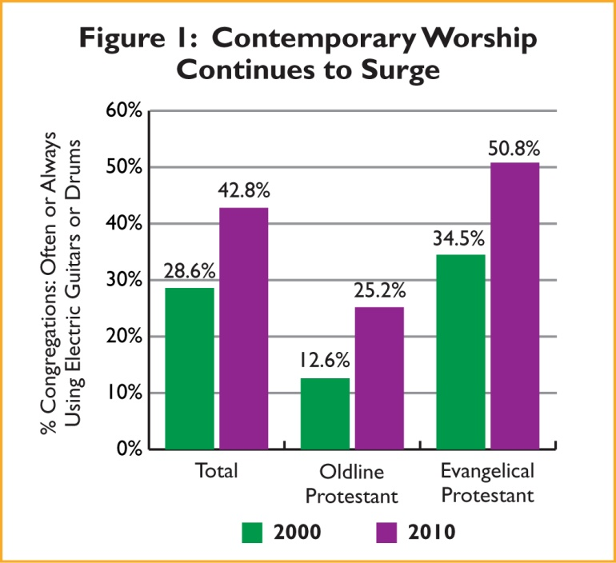
A Continued Increase in Innovative, Adaptive Worship
‘Nowhere is the democratization of the sacred more evident than in the music sung in new paradigm churches. It is populist, written by common people whose lives have been transformed. And it is contemporary, drawing on the musical forms of popular culture. Social movements, both secular and religious, have often been accompanied by a radical shift in musical expression. Music reflects the deep unconscious structures of a culture, and correspondingly, the music of social movements signals discord with those routinized structures. Movement music simultaneously symbolizes a break with the old and provides a source of cohesion for those choosing the new way.”
Reinventing American Protestantism: Christianity
In the New Millennium, Donald E. Miller

Slide 13
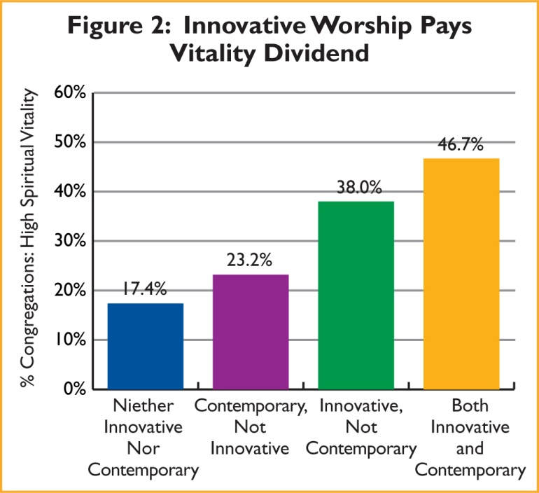
But It Is Really Innovative Worship That
Pays The Strongest Vitality Dividend
Think for a moment – What is the most magnificent & inspirational worship service you have ever experienced?
Would your worship attendance increase if every service was like this? Would the depth of your spiritual commitment deepen?
What kind of worship might do the same things for
your kids/ grand children/ nieces or nephews?

Slide 14
Continuing
High
Levels of
Conflict
Conflict In One or More of Four Key Areas* in Past Five Years
*Four Key Areas:
⬧ Worship
⬧ Finances
⬧ Program Priorities
⬧ Leadership

Slide 15
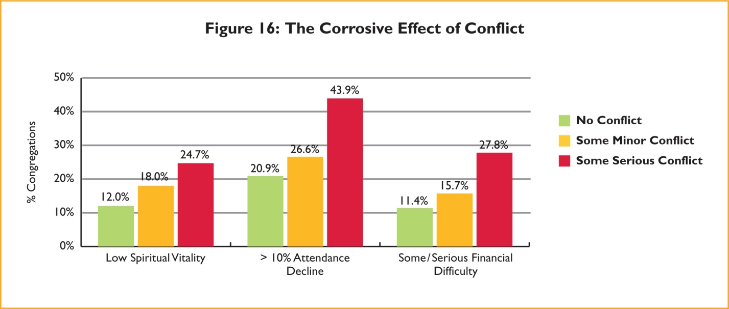
Conflict Typically Thought Of As, And Can In Fact Be
A Bad Thing
■ No Conflict  Some Minor Conflict  Some Serious Conflict

Slide 16
But The Most Significant Implication of Conflict for Congregations Today
Is Conflicts Relationship To CHANGE
◆ Vitality and Growth
Typically Require Change
Percent Rapid Attendance Growth
❖ Change Typically
Produces Conflict
Percent Serious Worship Conflict
Worship Change In Past 5 Years
⬥ Vitality and Growth Typically Require Managing Conflict
Percent Rapid Attendance Growth
Worship Change
Worship Conflict

Slide 17
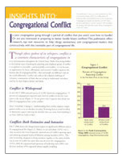
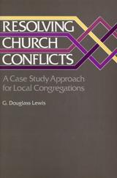
Buffers Against Serious Conflict
Fortunately, There Are
Resources For Dealing
With Conflict
Insights Into: Congregational Conflict
Is your congregation going through a period of conflict that you aren't sure how to handle? Or are you interested in preparing to better handle future conflicts? This publication offers research, tips and resources to help clergy, seminarians, and congregational leaders deal constructively with this inevitable part of congregational life.
Download it @ www.FaithCommunitiesToday.org
Resolving Church Conflicts:
A Case Study Approach for
Local Congregations
by G. Douglass Lewis

Slide 18

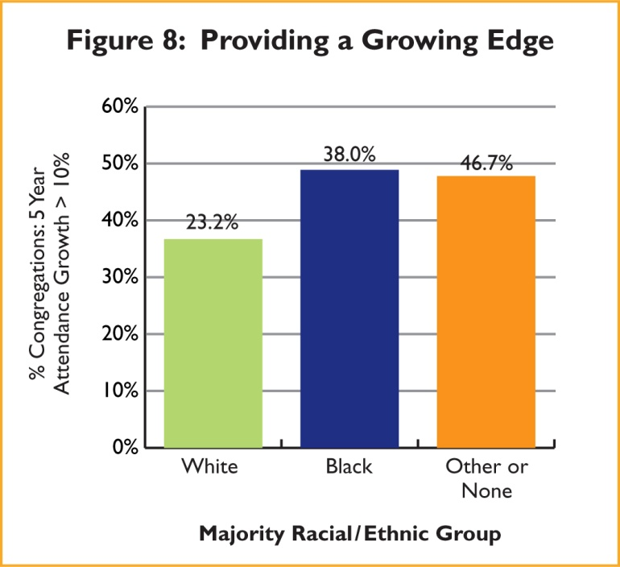
Considerably More
Ethnic
Predominantly Racial/Ethnic Minority Congregations:
% Of All U.S. Congregations
Ten percent Or More
5-Year Attendance Growth
And, More
Likely To Be Growing

Slide 19
The Number of Multiracial Congregations is also Increasing
(Congregations with no more than 80% of participants from any given racial/ethnic group)
Percent Multiracial Congregations
2010 Percent Multiracial
Congregations By Family
35.4%
Percent Rapidly Growing

Slide 20
Syllabus
American Religious Trends: Changing World, Changing Ministry* (RS-644) | NEW
Monday, June 3 through Friday, June 7, 9 a.m. to 5:30 p.m.
﻿Most religious leaders are well aware that the world is no longer flat. But neither is it any longer helpful to think of it as round, although it is global to be sure. How do we capture the ethereal and ephemeral nature of the emergent world in which we now are called to religious leadership? A world that, somewhat ironically from a religious perspective, has in only a few years moved from the earthiness of being “wired” to the heavenliness of “the cloud.” And what does it all imply for ministry – both in theory and in practice? Focusing on the American context, these are the questions this course will address – a third on the broad and dramatic demographic and socio-cultural changes of the last quarter century, a third on their implications for ministry, and a third on promising approaches to developing new religious habits and renewed religious communities for the changing world. Among the topics to be covered drawing on lectures, discussion, case studies, guest speakers and students’ experience: the growing generation gap and the disenchantment of the young adult world; the promise and peril of an increasing diverse world (from pluralism to polarization), triaging with purposefulness, spiritual practices and innovative worship, the seeming incongruity of a “missional” cloud, and mega ministries in increasingly smaller congregations.
Further Resources on Congregations & Change
Hartford Seminary Courses and Events, www.hartsem.edu
Webinar: Supersized Believers: What Megachurches Tell Us
About The Spiritual State of Americans And How to
ReachThem Thursday, May 23, 2013 at 8 p.m.
Course: American Religious Trends: Changing World,
Changing Ministry Monday, June 3 through Friday,
June 7, 9 a.m. to 5:30 p.m
Hartford Institute Publications, www.FaithCommunitiesToday.org/
The Other 80 Percent: Turning Your Church's
Spectators into Active Participants
Scott Thumma, Warrant Bird
FACTs on Growth 2010
C. Kirk Hadaway
A Decade of Change in American
Congregations: 2000 - 2010
David A. Roozen
Most recent and encyclopedic book on religious change in the united States
American Grace: How Religion Divides and Unites Us Robert D. Putnam and David E. Campbell
David Roozen, Director
Hartford Seminary Institute
For Religion Research
roozen@hartsem.edu

