Slide 1
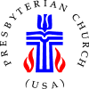
“They don’t look like Presbyterians to me!” Reinventing new church development
Angie Andriot, PhD
Deb Coe, PhD
Presentation for
Society for the Scientific Study of Religion
October 2016
Notes:
In light of decades of decline, several mainline denominations are renewing efforts to start new congregations. The Presbyterian Church (U.S.A.) is among them. At its 2012 General Assembly, leaders encouraged the creation of 1,001 new worshiping communities (NWC) between 2012 and 2022. The goal of this initiative is not necessarily numerical growth, but rather helping the denomination move from an inward focus on worship and membership counts to an outward emphasis on mission and discipleship.
This presentation is based on three of the research projects designed to track this initiative: a Presbyterian Panel survey measuring perceived impacts on congregations that partner with a new worshiping community, a survey of NWC leaders, and interviews with NWC leaders conducted at the annual 1001 NWC conference.

Slide 2
“THEY DON’T LOOK LIKE PRESBYTERIANS TO ME.”
Notes:
We found that these communities share four key characteristics: emergent, missional, contextual, incarnational. And then we’ve also learned that new worshiping communities look different than your typical Presbyterian congregation. But this movement is not unique to PC(USA); it is, in fact, part of a broader set of emerging church movements in the U.S. and around the world.…

Slide 3
God grows churches, not just individual Christians (1 Corinthians 3:6-9; 12:13)
Those starting churches must do so from within the cultures they are trying to reach (1 Corinthians 9:19-23)
Notes:
Fresh expressions is an Anglican movement started in the U.K. Although it began on its own, the movement was formalized in 2005 by the Church of England and the Methodist Church. It’s all about ways of doing church for people who don’t go to church. (http://www.churchgrowthresearch.org.uk/fresh_expressions ; http://churcharmy.org.uk/fxcresearch )
In their own words, “A Fresh Expression is a form of church for our changing culture, established primarily for the benefit of those who are not yet part of any church.” http://freshexpressionsus.org/about/what-is-a-fresh-expression/
While each fresh expression is unique, there are some guiding principles that tie them all together. Fresh expressions are:
missional – serving those not currently served by any church;
Incarnational/contextual – listening to people and entering their culture;
Discipling/educational – helping people enter more fully into the life of Christ;
Ecclesial/formational – forming church.
Similar to this is the Emerging Church Movement. This is a postmodern movement within American Christianity, which began in the late 90s and seeks to:
overturn what movement members see as conventional and destructive interpretations of the Gospel
transform religious institutions so they are less hierarchical
Take Christianity outside the walls of church buildings to serve those outside church
( http://collegevilleinstitute.org/wp-content/uploads/2013/12/Bearings5forWEB.pdf )

Slide 4
New
Seeking to make and form new disciples of Jesus Christ
Taking on varied forms of church for our changing culture
Worshiping
Gathered by the Spirit to meet Jesus Christ in Word and Sacrament
Sent by the Spirit to join God’s mission for the transformation of the world
Community
Practicing mutual care and accountability
Developing sustainability in leadership and finances
Notes:
Similar to this is the 1001 new worshiping communities movement happening in the Presbyterian Church (U.S.A.).
In June 2012, the 220th General Assembly declared a commitment to a churchwide movement that results in the creation of 1,001 worshiping communities over the next 10 years. At a grassroots level, over 300 diverse new worshiping communities have already formed across the nation.
http://www.onethousandone.org/#!about-1001/c19jr
http://www.onethousandone.org/#!define-new-worship-comm/c235g

Slide 5
New Worshiping Communities
Emergent
Missional
Contextual
Incarnational
Notes:
New worshiping communities are, by definition, emergent. This is a grassroots movement within PC(USA) in which we facilitate the creation of communities. These are not church plants, and they are not controlled as such. In addition, our research shows that these communities share three key features: they are missional, contextual, and incarnational. In this way, they are very similar to the Fresh Expressions and Emergent Church movements.
Emergent – “in the process of becoming.” We can apply this to the community itself, but we can also apply it to the target market of worshiping communities – those “nones” and “dones”, that they hope to reach and put on the “process of becoming” Christian (though some research on “dones” in particular, indicates many still identify as Christian, just are “done” with institutional religion.
Missional – What is “missional”? Is it about evangelizing or serving? What about “friendship evangelism” and “service evangelism”?
Contextual – meeting people where they are, and taking their culture into account. This creates a great diversity both within and between worshiping communities.
Incarnational – being the “hands and feet of Christ”
Hope Presbyterian Church at Lake Nona reflects this well in their stated priorities: “God before all, Kingdom before congregation, people before property, love before doctrinal precision.” In this statement, Hope Nona has eloquently summed up what seem to be the main priorities of so many other new worshiping communities at the conference we attended – an outward focus on mission and relationship-building out in the community rather than emphasizing worshiping and strengthening the church itself.

Slide 6
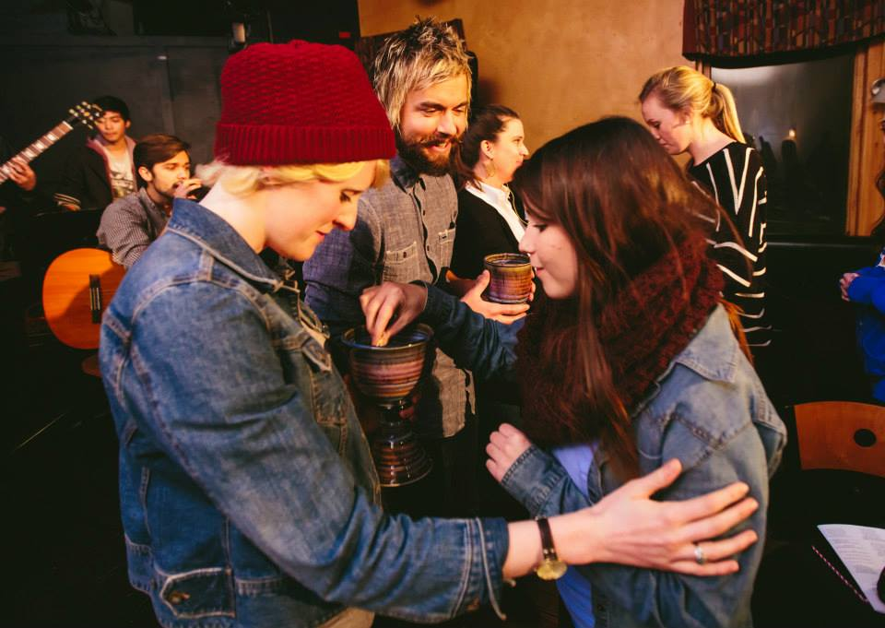
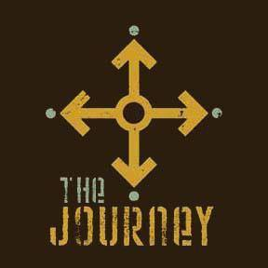
Emergent
Notes:
“The Journey is a worshiping community for college students that offers Presbyterians, non-Presbyterians, the spiritually curious, skeptics, and even Red Sox fans to grow spiritually while at college. We are open-minded, passionate, and committed to advancing the Gospel and glorifying God in our daily lives. Supported by a network of partner churches, a strong student leadership team creates regular opportunities to experience authentic Biblical community and participation in the Missio Dei (“Mission of God”).”
Their vision statement: Question. Explore. Transform.
They are an inclusive community on a spiritual journey that:
Asks questions about the beliefs and practices of ourselves, others, and the culture in a safe environment.
Explores what it means to follow Jesus and his teachings in this generation.
Is transformed by God as we participate in the mission of God to transform the world around us.
http://www.charlestonjourney.org/ (includes video)

Slide 7
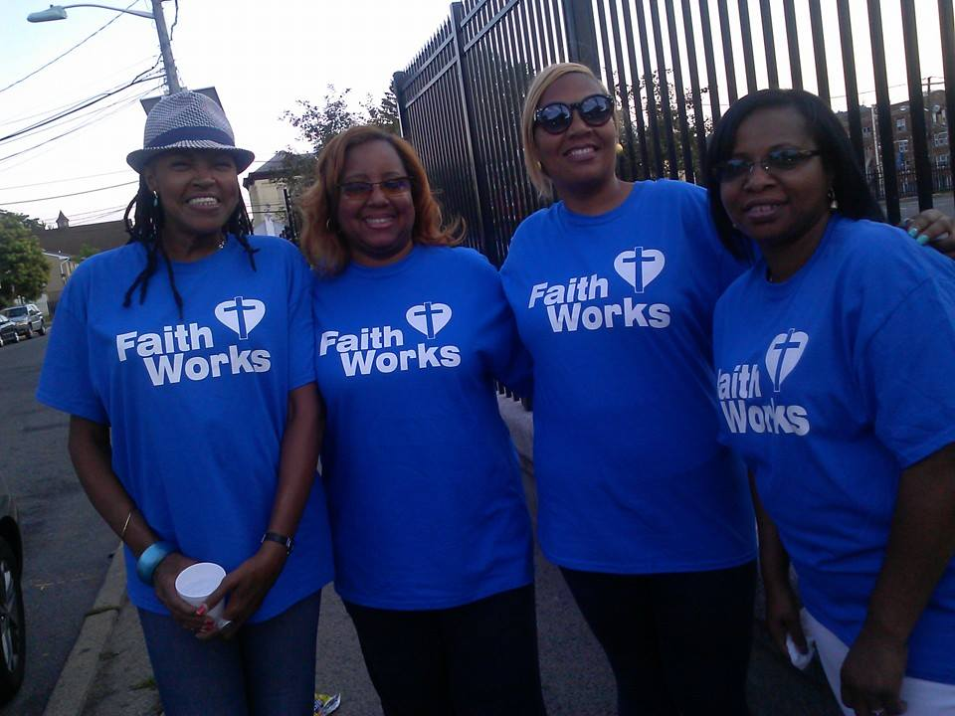
Missional
Notes:
The people we spoke with at the 1001 conference primarily emphasize service and mission as their way to honor God by being God’s “hands and feet.” And, through modeling this behavior publicly and around non-Christians, they hope to bring more people to God in a subtle, less “fire and brimstone” manner. The idea is to “show the Gospel” rather than to “tell about it.” This reflects what we found in the 2014 survey of worshiping community leaders, where we found that building relationships was a top priority among worshiping communities, and many emphasize mission as their mission.
They also mention the importance of going out into the community and working side-by-side with non-Christians as well as other Christians. In this strategy, leaders often (but not always) emphasize the importance of not engaging in God-talk while doing service activities.
Service evangelism is not always separate from God-talk and traditional worship.

Slide 8
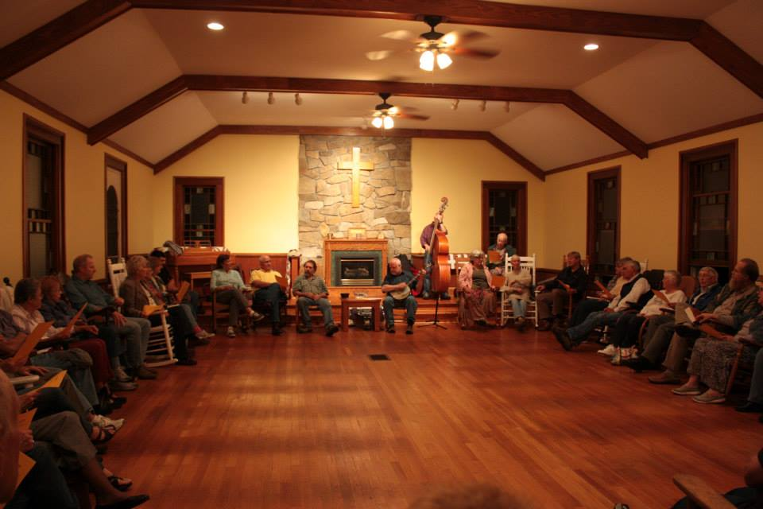
Contextual
Notes:
What do bluegrass, rockingchairs, supper and square dancing have in common?
If you said they’re all part of an awesome night, you’re right. But did you ever think they could be part of church?
Wild Goose Christian Community is a nontraditional worshipping community in Appalachia.
Pews have been replaced with rockers, organs with banjos, and goblets with Mason jars. Additionally, Wild Goose has moved away from traditional, preacher-based worship into incorporating the congregated group; discussions occur instead of sermons. Through these means, Wild Goose creates a vivid and extremely unique Appalachian experience for participants in the Uprisings.
Wild Goose seeks to reach out to folks who have been embittered by traditional churches as well as those seeking additional and alternative worship services.
http://wildgoosecc.com/
https://www.youtube.com/watch?v=yNEcz2fFGGg

Slide 9
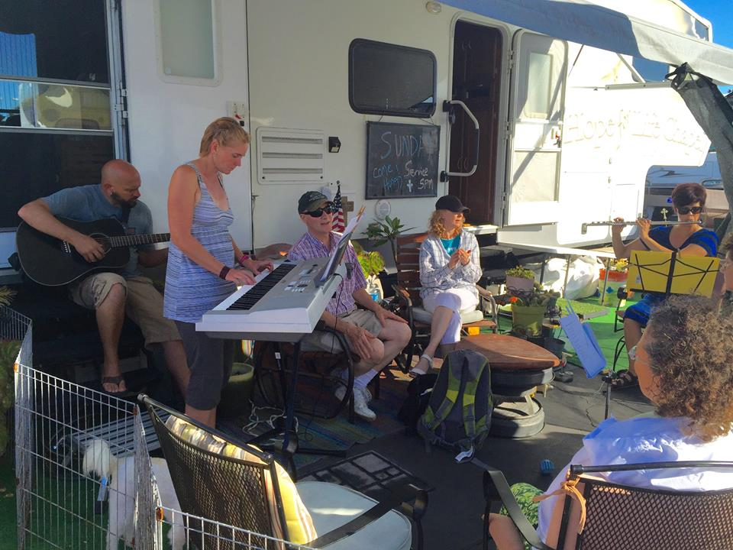
Incarnational
Notes:
Reaching out to the “dones” (i.e. “dechurched”) is a common goal among many worshiping community leaders, and the strategies for reaching this group often involve long-term planning. One example of this process is in Tamara John’s RV ministry Hope for Life Chapel. Tamara has found success through a blend of testimonial and interpersonal evangelism. Like The Fellowship Place, Tamara does not shy away from the term “evangelism,” and describes herself as an evangelist for the PC(USA). Tamara’s evangelism involves reaching out to others and building trust by first sharing her own story, and through this testimony showing how God’s love can transform and heal. It is only once the walls people build around themselves are down, that community can begin to build.
Hope for Life Chapel RV Ministry reaches out to the desperate, unloved, dechurched and unchurched people at an RV Park. Some have lost their homes, are going through a divorce, are sick and need to be near a hospital or are, because of their choices or other people's choices, in an upside-down emotional situation. Rev. Tamara John lives in a fifth-wheel RV custom made with a 12X10 chapel in the back part. She has group gatherings, does pastoral counseling, and prays with people. She helps find resources needed, but also is a caring presence through listening, encouraging, and sharing God's love and peace that surpasses all understanding.
https://www.youtube.com/watch?v=d8GsbvcZpMw

Slide 10
Notes:
The population of these worshiping communities is much more diverse than the PC(USA) as a whole. Fifty-three percent of the members in these communities are people of color, compared to only 8% of the PC(USA).

Slide 11
Notes:
This slide shows the percentage of worshiping communities vs PC(USA) congregations that have 80% or more participants in each racial group. Although the overall racial distribution of these communities is more diverse than the PC(USA) as a whole, there is still some racial segregation; 34% of leaders report that their community has no racial diversity (i.e., they are comprised entirely of participants from a single race-ethnicity).
Sixty-eight percent of the worshiping communities have more than 20% racial-ethnic participation. In comparison, only 13% of Presbyterian congregations that reported racial-ethnic data in 2013 had more than 20% racial-ethnic membership. These communities are bringing greater diversity to the Presbyterian Church (U.S.A.).

Slide 12
Age Distribution
Notes:
The people in these worshiping communities are younger than the typical Presbyterian.
The largest age group for worshiping community participants is 19-39 years old, with 43% of participants falling into this age range. In comparison, the largest age group for the Presbyterian Church (U.S.A.) is over 65 years old, with 32% of members falling within this age range. Half (50%) of the Presbyterian Church (U.S.A.) is over the age of 55, whereas nearly two-thirds (64%) of worshiping community participants are under the age of 40.

Slide 13
Notes:
Previous church involvement varies widely among participants in these communities; however the most common category is participants who previously participated in a church of another denomination. Twenty-three percent of community participants were already attending a PC(USA) congregation before joining their community. This means that up to seventy-seven percent of new community participants are also new to the denomination. This indicates that the 1001 New Worshiping Communities movement is potentially bringing more people into the Presbyterian fold, and not just moving members around.
In fact, when leaders were asked where they have seen the Holy Spirit at work in their community, many noted their community’s ability to bring the unchurched and de-churched into their community–and that this process sometimes requires healing work, as many de-churched are hurt by past church experiences:
“Many in our community have been quite wounded by their experiences with churches, so one of the biggest things is that the Spirit has brought this group together and many of them (including myself!) are working towards healing those wounds…”
“People who have completely given up on church and mostly given up on God are discovering a renewed passion for their relationship with God and growing in their faith.”
“People are getting connected with us and participating in worship and mission after many years of giving up on the church.”
“I’ve seen people who didn’t want anything to do with ‘God’ spend time talking about God and coming back over and over again to the worshiping community.”

Slide 14
