Slide 1
Engaging Young Adults: Findings from the FACT 2015 Survey of U.S. Congregations
Kristina Lizardy-Hajbi, Ph.D.
United Church of Christ

Slide 2
Overview
Report available: www.faithcommunitiestoday.com
4,436 congregations
Completed by key informant
Cooperative Congregational Studies Partnership (CCSP) through Hartford Institute for Religion Research (HIRR)
2000, 2005, 2008, 2010, 2015

Slide 3
General Landscape
Notes:
Nearly one in five congregations (18%) reported no young adult presence in their congregations in FACT 2015. This is a significant increase from 2010 when less than 8% reported no young adults at all. Overall, the average percentage of young adults in American congregations decreased from 14% of active participants in 2008 to 11% in 2015 (Figure 1).
Despite overall declines, many congregations do have young adult participants and report a thriving young adult ministry. Nearly 82% of congregations have at least one young adult participant, though this does not necessarily translate to having a thriving ministry for them. One hopeful sign for congregations with at least one young adult is that the vast majority (85%) either increased or maintained their numbers for this age group over the last three years.

Slide 4
Young Adults in U.S. Congregations: Five Practical Findings
1. Context matters a great deal, as young adults are not a monolithic demographic.
Notes:
There are varying perceptions—accurate and inaccurate—about young adults in congregations today. Beyond that, some congregations tend to hold up certain idealized versions of the types of young adults that they desire to attract, with particular end goals in mind. For example, one congregation may want to attract young married families with small children in order to grow the religious education program; another may seek to attract young, single working professionals who can boost the congregation’s finances. Based on the data collected from American congregations, it appears that these perceptions need to be a bit more nuanced and are impacted greatly by the surrounding context of the congregation.
Nearly half of all young adults in American congregations are married with children. However, most young adults are not married. Interestingly, these percentages do not change significantly based on whether the congregation has increased, stayed the same, or decreased its young adult participation in the last three years.
The family status of young adults is related to geographical context in ways that one might expect. Higher average percentages of both single and partnered/engaged young adults without children are present in downtown urban congregations. Higher average percentages of married young adults with children are found in more rural and small town congregations.

Slide 5
Blue: Single (with or without children)
Red: Married with children
Notes:
Regionally, higher average percentages of single young adults attend congregations in the Northeast, even when accounting for geographical context and congregational size (Figure 16). Conversely, even though a higher percentage of congregations with 15% or more young adults are located in the West and South (Figure 2), it is important to note that congregations in these regions have a greater average share of married young adults with children than single young adults.
Therefore, we know that context truly matters when it comes to young adult engagement, and knowing the demographics surrounding one’s congregations can make a significant difference in strategy and programming. Congregations with more singles also tend to be those with more young adults from nearby colleges or universities (as well as in downtown urban areas). Congregations with more young married couples with children also tend to be those in which more young adults come from nearby workplaces (rather than having young adults from nearby colleges/universities). The nuances of these relationships are subtle, but they demonstrate that certain contextual patterns are critical in attracting young adults.

Slide 6
Notes:
Perhaps the most striking finding is that 70% of active young adult participants within any given congregation come from families within that congregation, meaning that they are related to other members (Figure 17). While some young adults do engage with congregations because of proximity to workplaces, colleges, universities and military bases, these types of settings are known to be highly transitory which could account for young adults’ overall absence within congregations. Generally, congregations with young adults from nearby colleges or universities are over four times more likely to be located in areas in which 18-34 year olds make up a critical mass (at least 15%) of the population. In comparison, congregations with young adults related to families within those congregations are equally likely to be in low- or high-density young adult population areas.
In the end, some of the long-held assumptions about young adults hold true; but newer findings around the prevalence of familial/generational young adult participation in congregations is an area worthy of further exploration and also intersects with other important research on young adults and faith.

Slide 7
2. Thriving congregations = thriving young adult ministries/ congregations
Notes:
Many of the factors found in thriving (as well as growing) congregations also hold true for congregations with higher percentages of young adults. As chronicled in previous FACT reports, growing congregations engage young adults better, have more innovative worship, are more actively involved in recruiting more people, engage in greater use of electronic technology and the internet, and are often more racially/ethnically diverse, among other characteristics. Congregations with thriving young adult ministries (referred to below as “thriving young adult congregations”) also possess many of these same vitality marks.

Slide 8
3. Both prioritizing young adult ministry and creating a specific strategy for engaging young adults are necessary for a thriving young adult congregation.

Slide 9
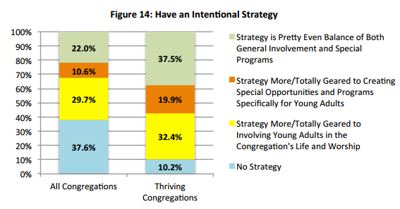
Notes:
Congregations engage with young adults in myriad ways; but before highlighting significant trends, it is important to explore strategies undergirding this engagement, or the lack thereof. Congregations undertake a number of different strategies for engaging young adults. Depending on the strategy, outcomes vary. Figure 14 illustrates various strategies and how frequently they are used by different congregational groupings. In total, over one-third of all congregations have no intentional strategy for young adult ministries. Conversely, nine in ten congregations with thriving young adult ministries have some intentional strategy for engaging young adults.
Generally, smaller congregations (100 or fewer in worship) are nearly two times more likely to have no strategy for engaging young adults than larger congregations (over 100 in worship). Not surprisingly, these larger congregations are more likely to have a strategy geared toward creating special opportunities and programs specifically for young adults, given the increased financial and other resources available within these congregations.
It turns out that both prioritizing (shown previously in Figure 8) and having a strategy for young adult engagement are strongly related to higher percentages of young adults within congregations, regardless of the size and location of the congregation. For those congregations with no intentional strategy and no prioritization of young adults, the average percentage of young adult participants is quite low (less than 7%). Significantly, different strategies and levels of prioritization result in different outcomes for congregations. For example, if the strategy is totally geared toward involving young adults in the general life and worship of the congregation, but young adult engagement is not a priority; the likelihood that the congregation will have young adults in the congregation is nearly nonexistent (average young adult percentage in these congregations is around 3.5%). It appears that these congregations really do not have an intentional strategy for engaging young adults and most likely assume that what is already offered in worship and programming should automatically attract young adults. Strategy (a plan) and prioritization (taking steps to act on that plan) are both necessary to create thriving young adult ministries.

Slide 10
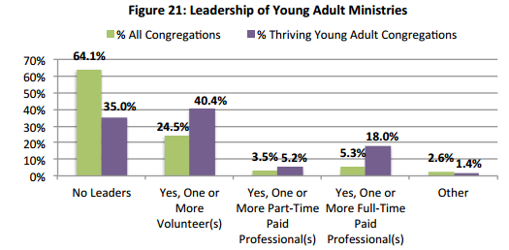
Notes:
Prioritizing and strategizing should include dedicating people and time to young adult engagement, but it doesn’t need to be paid staff!

Slide 11
4. Worship is (still) the most frequent way that young adults connect with congregations.
Notes:
It is also important to explore the nature of young adult religious participation. On average, nearly 70% of young adults participate by attending worship and about half (46%) participate in programs/activities other than worship. This involvement varies by size, however, with congregations of 100 or fewer in worship reporting higher worship attendance by young adults (Figure 18). This could be due to smaller congregations having fewer options for programming, so worship tends to be the main gathering opportunity for all participants. Interestingly, there is virtually no difference between smaller and larger congregations in terms of the percentage of young adults who participate in activities other than worship. Smaller congregations often believe that the key to attracting more young adults is creating more programs and activities, but this finding directly refutes that assumption.
With regard to worship, thriving young adult congregations are more likely to report higher ratings on all named worship descriptors, which include worship being innovative, reverent, thought-provoking, filled with a sense of God’s presence, inspirational, and joyful. These congregations also report more frequent use of a variety of instruments in worship, including the organ, drums or other percussion, and electric guitar/bass. While trends from past FACT survey findings still hold true that young adults are attracted to electric guitars and drums, results of this latest survey also suggest that many young adults participate in worship with more traditional instruments like the organ.

Slide 12
5. Improving young adult presence/ministries within congregations requires passion, not dollars.
Notes:
The fact that American congregations believe more interest on the part of young adults is essential, while at the same time recognizing their own lack of desire/passion to reach out to this age group, highlights a paradox that must be examined more thoroughly. Underlying assumptions regarding young adults themselves may, in large part, be a contributing factor hindering many congregations from developing an intentional strategy or prioritizing ministry with this population. For example, stereotypes of young adults as lazy, inattentive, materialistic, and not interested in spiritual matters might contribute to a congregation’s overall lack of desire to engage this population. Furthermore, age and generational differences between participants in a majority of American congregations (largely made up of Baby Boomers) and Millennials, who make up a larger percentage of the general population, may exacerbate those assumptions. In order for congregations to truly garner the interest of more young adults, it may also require significant changes in the overall structures and practices of faith communities. If there is little openness to change, or a lack of willingness to meet new challenges, then attracting young adults will be an uphill battle.
As we said at the outset, creating a future in which young adults are a significant part of American congregational life is not an easy challenge. As this report has demonstrated, a number of factors—both internal and external to congregations themselves—impact success in engaging this population. In the end, there is no “magic bullet,” no single solution that will turn congregations into places where young adults are both welcomed into an existing structure, and also empowered to transform those structures in ways that are meaningful for them. Passion and intentionality—in the form of strategies, priority, people, and time—are essential for cultivating this ministry; but ultimately, these things are necessary for building any thriving ministry. We can no longer expect that young adults will come through the doors of congregations on their own. Instead, we must make it a priority to go beyond our walls in order to engage this generation and co-create truly thriving communities of faith.

Slide 13
Website
www.faithcommunitiestoday.org
Facebook
Faith Communities Today
Other FACT 2015 Reports
American Congregations 2015: Thriving and Surviving
Teaching and Learning in American Congregations

